Slide 1
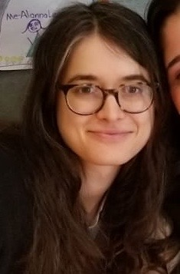
Catherine
347-266-9132
Gladys
917-891-1306
Daniela
646-874-4852
Lehyla
917-912-0496
Didi
646-479-3438
Natalie
917-612-3879
Anabel
347-613-6629
Judy
917-536-5004

